Slide 1
Battery Management System For EV

Slide 2
Objective of BMS
A battery management system (BMS) is any electronic system that manages a rechargeable battery (cell or battery pack)
To Measure parameter like (Voltage, Current, Heat, Charging& Discharging.
To protect the battery from operating outside its safe operating area (SOA) and prolong its lifetime
Monitoring its state continuously
Calculating secondary data, reporting that data
Controlling its environment, authenticating it and / or balancing it.
Thermal Management
To perform battery cell balancing
To determine the SoC
To determine the SoH
Communicate to other units and vehicle control unit (VCU)

Slide 3
Battery Management System

Slide 4
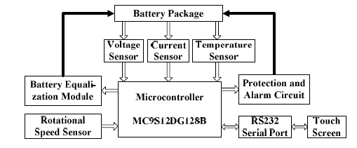
Battery Management System

Slide 5
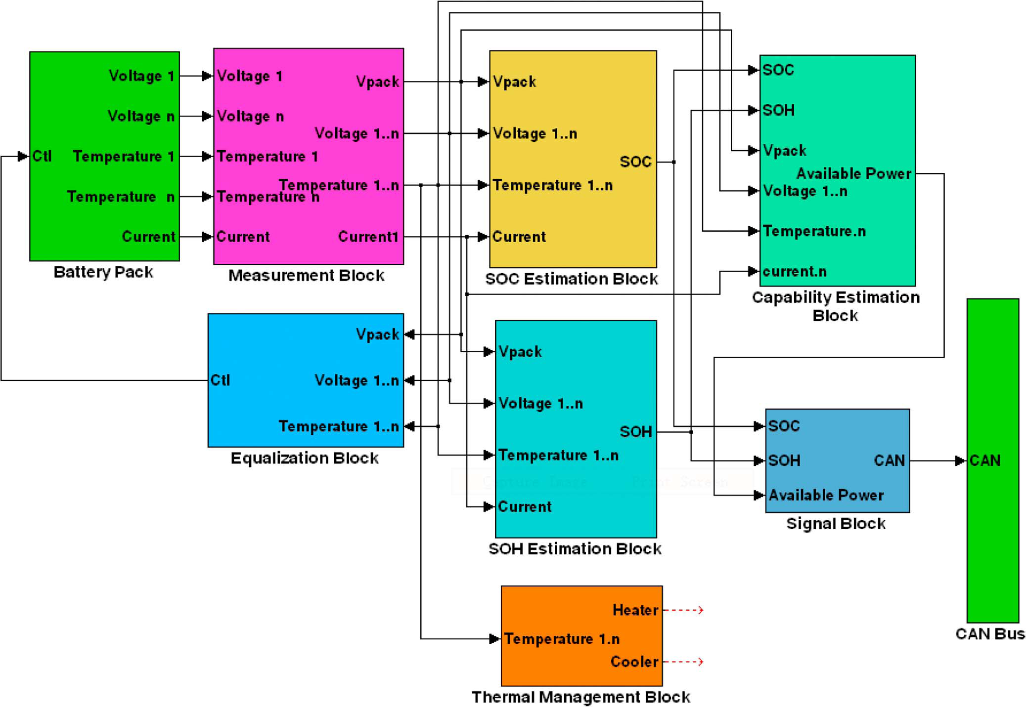

Slide 6
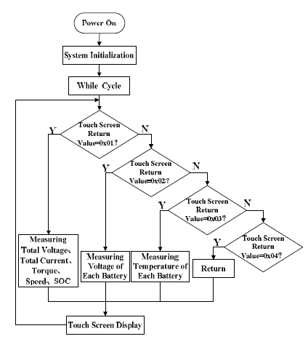

Slide 7
Functions of Battery management system
BMS may monitor the state of the battery as represented by various items, such as:
Voltage: total voltage, voltages of individual cells, minimum and maximum cell voltage or voltage of periodic taps
Temperature: average temperature, coolant intake temperature, coolant output temperature, or temperatures of individual cells
State of charge (SOC) or depth of discharge (DOD), to indicate the charge level of the battery
State of health (SOH), a variously-defined measurement of the remaining capacity of the battery as % of the original capacity
State of power (SOP), the amount of power available for a defined time interval given the current power usage, temperature and other conditions
State of Safety (SOS)
Coolant flow: for air or fluid cooled batteries
Current: current in or out of the battery

Slide 8
Additionally, a BMS may calculate values based on the above items, such as:
Maximum charge current as a charge current limit (CCL)
Maximum discharge current as a discharge current limit (DCL)
Energy [kWh] delivered since last charge or charge cycle
Internal impedance of a cell (to determine open circuit voltage)
Charge [Ah] delivered or stored (sometimes this feature is called Coulomb counter)
Total energy delivered since first use
Total operating time since first use
Total number of cycles

Slide 9
Protection
A BMS may protect its battery by preventing it from operating outside its safe operating area, such as:
Over-current (may be different in charging and discharging modes)
Over-voltage (during charging)
Under-voltage (during discharging), especially important for lead–acid and Li-ion cells
Over-temperature
Under-temperature
Over-pressure (NiMH batteries)
Ground fault or leakage current detection (system monitoring that the high voltage battery is electrically disconnected from any conductive object touchable to use like vehicle body)

